Slide 1
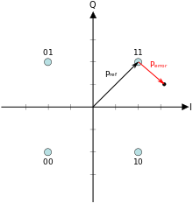
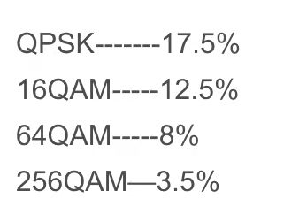
RIS-based antenna: Single stream transmission performance
Performance indicator and requirement
Error Vector Magnitude (EVM)
Definition
Error vector: a vector in the I-Q plane between the ideal constellation point and the received point
EVM: root mean square of error square normalized by ideal signal amplitude
Physical meaning: EVM measures how far the received symbols are from the ideal constellations.
Requirement: different requirements under various modulation modes
EVM requirement

Slide 2
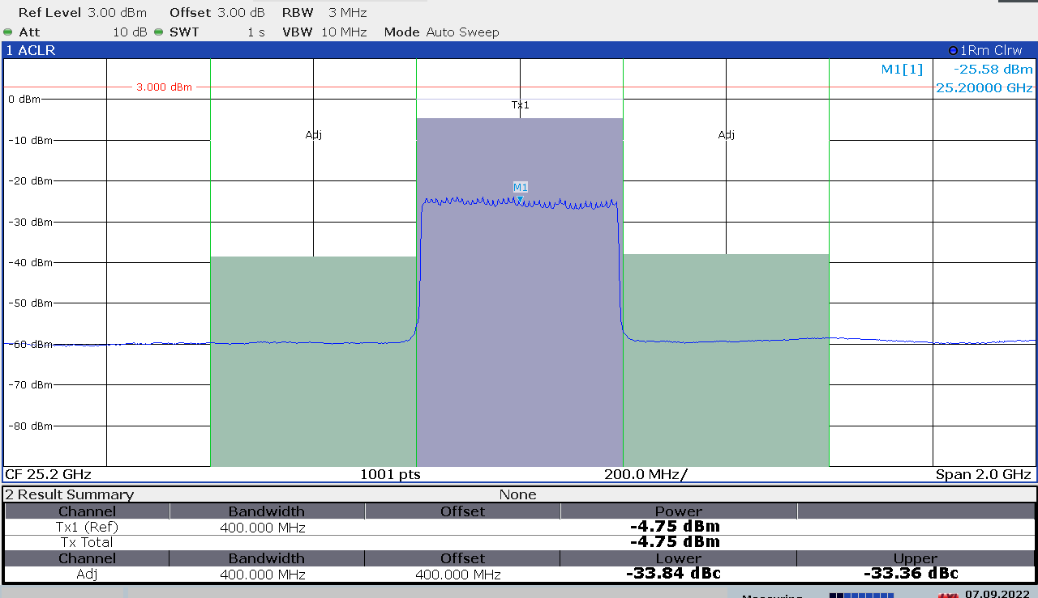
RIS-based antenna: Single stream transmission performance
Performance indicator and requirement
Adjacent Channel Leakage Ratio (ACLR)
Definition: ratio between the power within the designated channel and the power within adjacent channels
Physical meaning: a measurement of the interference to adjacent channels
Requirement: <-30dBc

Slide 3
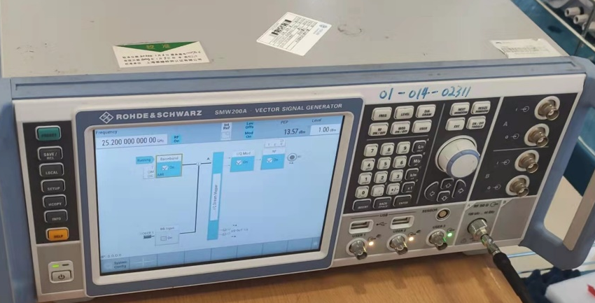
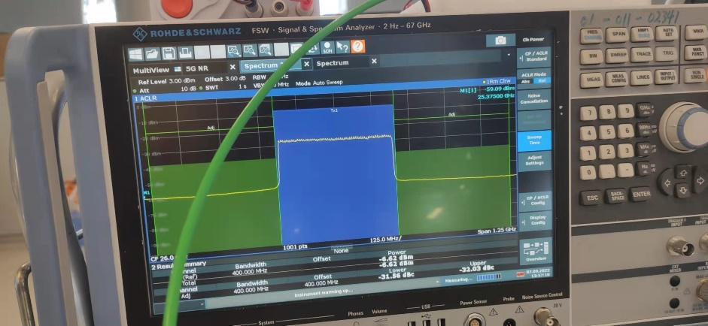
RIS-based antenna: Single stream transmission performance
Communication Prototype
One Transmitter
Vector signal generator (SMW200A): generate signal
One RIS-based antenna
One Receiver:
Horn antenna
Lower noise amplifier (30dB)
Spectrum analyzer (FSW): measure ACLR and EVM
Vector signal generator
Spectrum analyzer

Slide 4
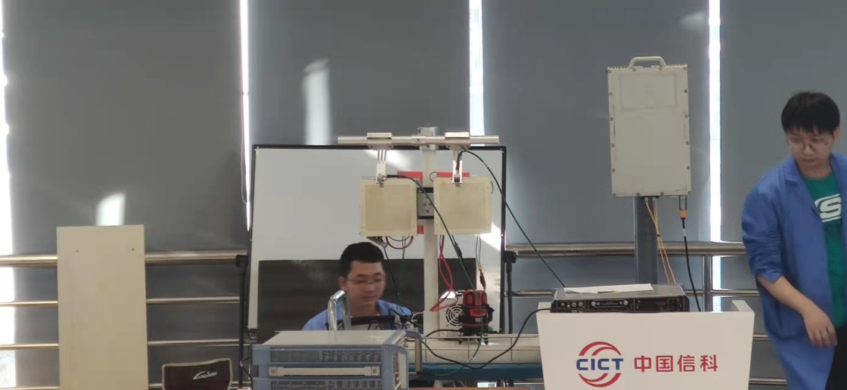
RIS-based antenna: Single stream transmission performance
Experimental setup
In a meeting room
Transmit power: 1 dBm
Transmit bandwidth: 400MHz
Adjacent channel bandwidth: 400MHz for each side
Tx antenna
RIS
Reflection angle
Feed
Rx antenna

Slide 5

RIS-based antenna: Single stream transmission performance
Experimental results
EVM (Reflection angle=$0^{∘}$)
ACLR (Tx-Rx distance=4m)
Conclusion: RIS-based antenna can support single stream communication with required ACLR and EVM under a wide range of Tx-Rx distances and reflection angles.
Tx-Rx distance (m) | 4 | 8 | 12 | 16 | 20
EVM (%) | 2.9 | 3.42 | 4.26 | 4.39 | 4.8
Reflection angle (degree) | 0 | 30 | 60
ACLR (dBc) | -33.36 | -35.51 | -30.44
Reflection angle (degree) | 0 | 30 | 60
ACLR (dBc) | -30.05 | -31.0 | -30.1
Table II. ACLR vs. reflection angle, with center frequency=25.2GHz
Table III. ACLR vs. reflection angle, with center frequency=26.8GHz

